Slide 1

EIS Datacenter Report – 6/4/2020
Gee, Jon, up the PPT game…

Slide 2

DDI Is Lunched! (It was delicious)
Few Numbers
700+ DHCP Scopes
63k Records
Outstanding Challenges
Printers & MFPs
IPAM – Managed vs. Unmanaged

Slide 3

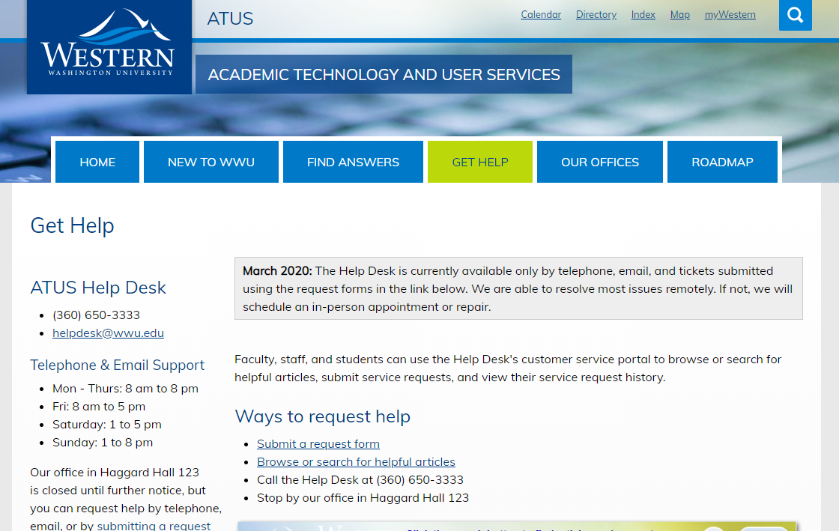
Where Do I go for DDI Changes?
https://atus.wwu.edu/get-help

Slide 4

Teams Migration
Hats off to Val & Folks
Over a 100 Users Migrated!
Outstanding
Room Systems (We got one!)
Skype for Business “Hiccup”

Slide 5
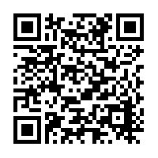
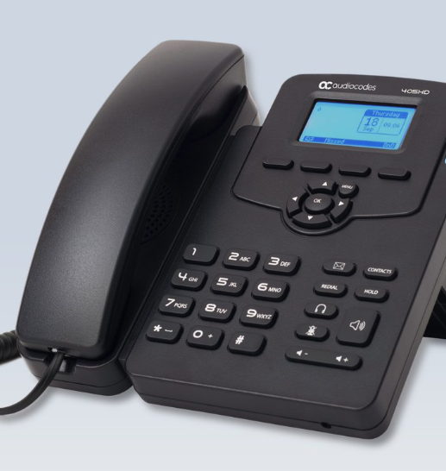

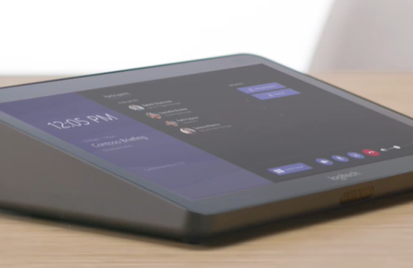
About The “Other” Stuff
Lots of Options
Recommendation – Logitech Tap Systems
Stick With USB!
Join with a Phone or another Device
Common Areas, Classrooms and Labs
Elevators & Emergency Devices

Slide 6

What are we working on this Month?
Maintenance Windows
Every Tuesday @ 5pm to Wednesday at 7am
Patch Reporting
Lansweeper Agent / Account
Nessus Account

Slide 7

Thanks!

